Slide 1
ArcGIS Pro Essentials
Basics of ArcGIS from Desktop Tutorials. MUST be viewed as a slideshow to see the process flow. Run it Auto or with the timings turned off. (Slide Show | Use Timings)
Ref: http://learn.arcgis.com/en/projects/get-started-with-arcgis-pro/
ACKNOWLEDGEMENT
This presentation is derived from the above page, with navigation and explanations added to simplify the learning process. While the presentation in its entirety remains the property of NCI, the knowledge base and some graphics in the above URL are owned by ESRI
Copyright © 2019 by National Computational Infrastructure, Canberra, ACT, Australia. Author: Dr. Arapaut V Sivaprasad.
10 January, 2018

Slide 2
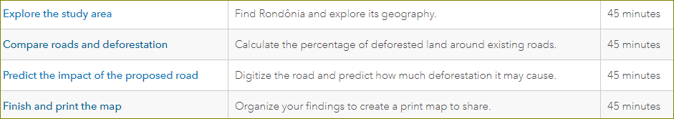
Lesson Plan
In this lesson, you'll use ArcMap to create a map of deforestation in the Brazilian state of Rondônia. Then, you'll predict how much deforestation would be caused by a road proposed to be built across the state. Your workflow requires a wide variety of data, feature editing, and analysis tools. You'll also learn how to share your results as an informative print map.
DISCLAIMER
This presentation is an animated flow of the steps in the four lessons listed above. It covers the process in about 10 minutes as compared to 3 hours by the lessons. However, it may not be an alternative to going through the lessons. Not every step is included in this animated presentation. The way to get the best outcome is to study both. Textual instructions in the lessons are easier to understand if you run this presentation at least once.
The copyright of this presentation is with NCI, whereas the knowledge base and some graphics are the property of ESRI.

Slide 3
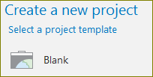
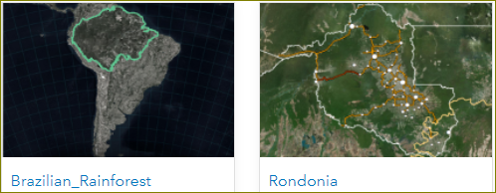
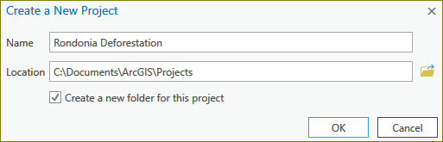
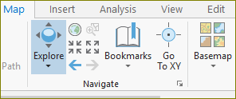


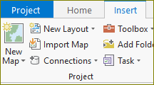
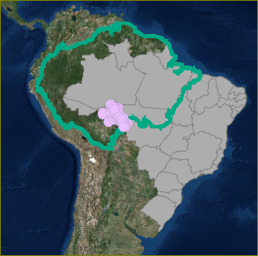
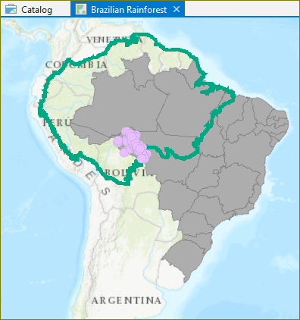
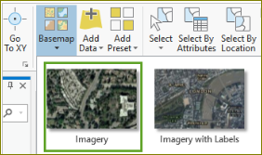
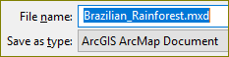
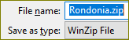
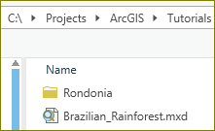
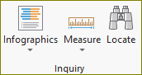
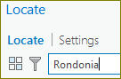
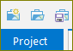
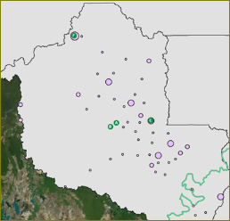
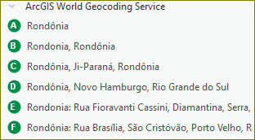
Explore the study area
Before you can make a map, you must first create a project. A project stores the maps, databases, toolboxes, styles, and other folders that may be useful when making your map. Then you'll import a map document with some of the data you need to start the map.
1. Go to the Get Started with ArcGIS Pro group.
2. Download and save the Brazilian_Rainforest.mxd file.
3. Download and save the Rondonia.zip file.
4. Open ‘Start | ArcGIS Pro’ desktop program.
5. Start a new project, ‘Rondonia Deforestation.aprx’
6. Import a map
7. Change the base map
8. Locate ‘Rondonia’
9. Save the project.
Next: Organise and symbolise data

Slide 4
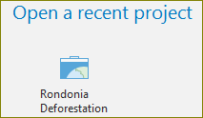
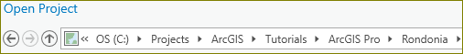
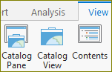
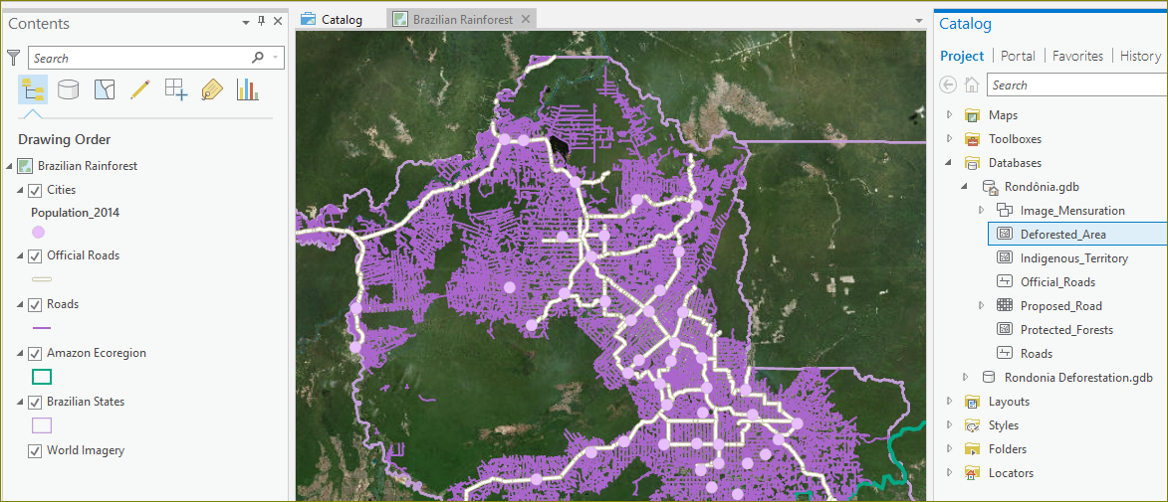
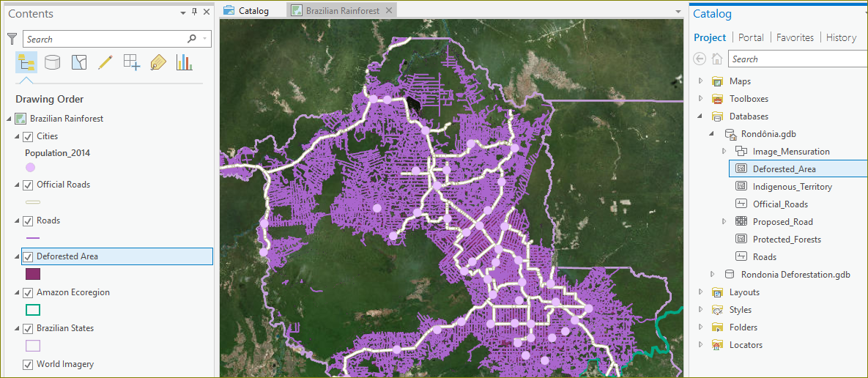
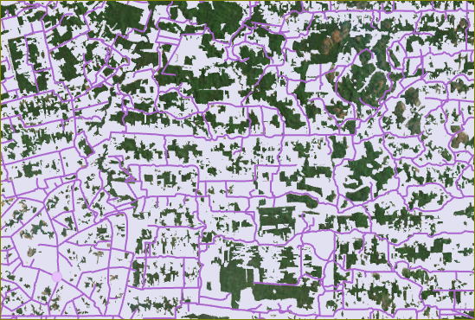
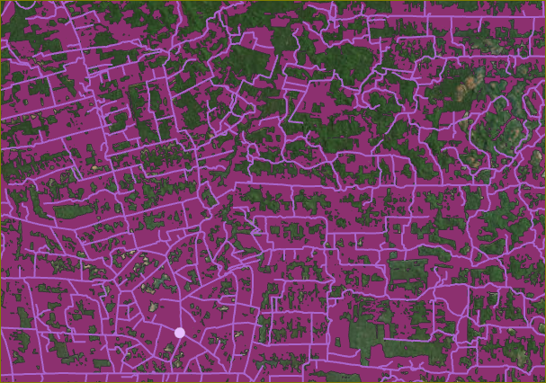
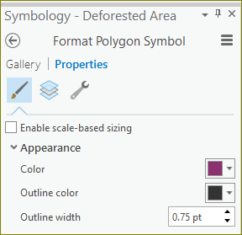
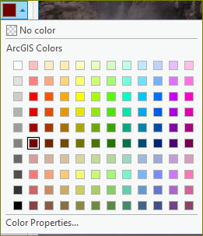
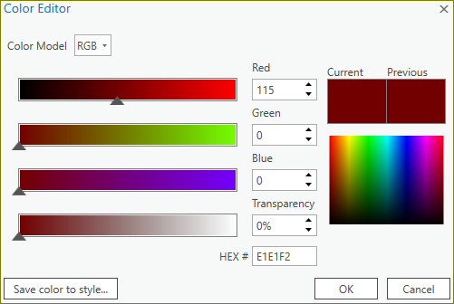
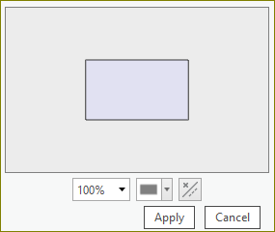
Explore Deforestation
Although you looked at deforestation in the last lesson, now you'll begin a more thorough exploration to understand existing deforestation patterns in Rondônia. You'll start by adding a layer that shows deforestation in the state.
OR
Deforested_Area
1. Open the Amazon Deforestation project in ArcGIS Pro.
2. Expand Catalog | Databases and drag ‘Deforested_Area’ to contents.
3. Change the color of the deforested areas.
Next: Protected Forests

Slide 5
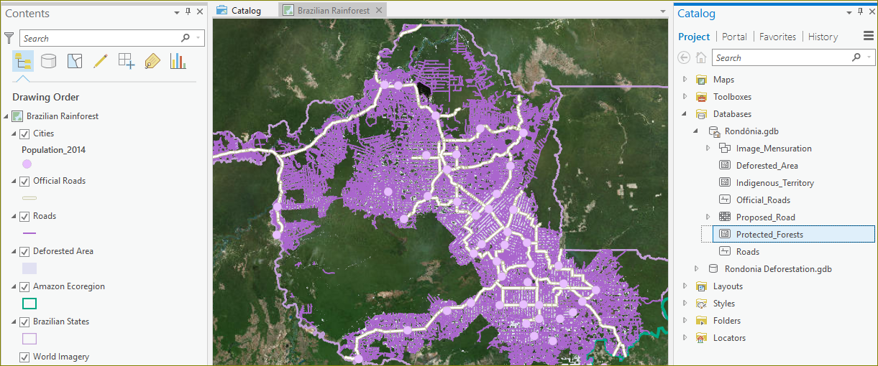
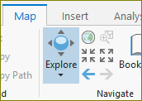
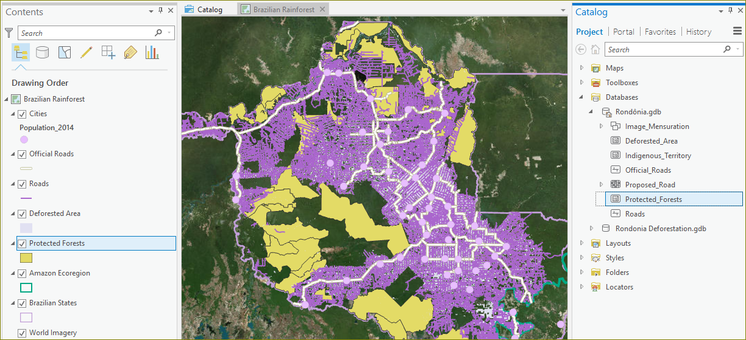
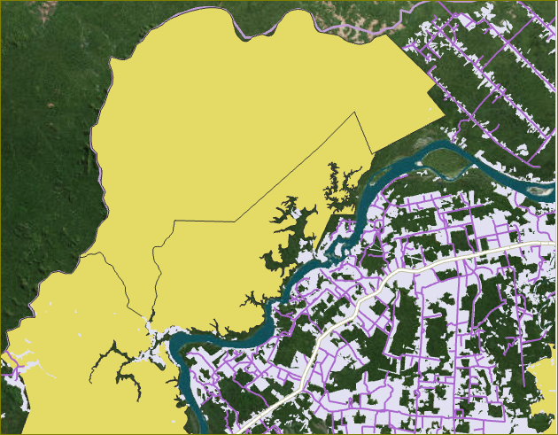
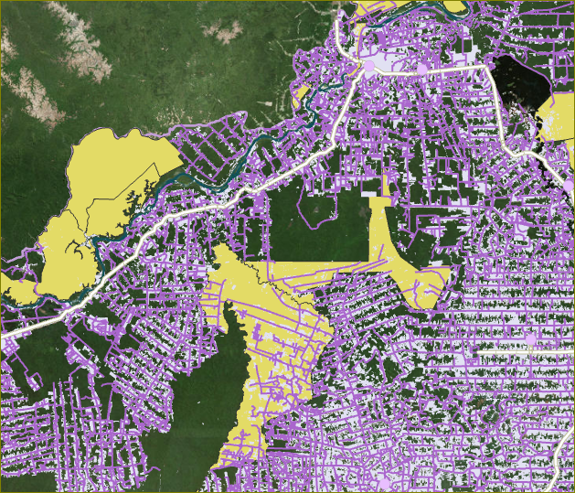
Protected Forests
Protected areas come in two types: protected forests and indigenous territory. Feature classes for both categories are in the Project Data geodatabase. You can add both to explore, but for this project you only need the data on protected forests.
Protected_Forests
1. Expand Catalog | Databases and drag ‘Protected_Forests’ to contents.
2. Zoom to inspect closely.
3. Click on ‘Explore’ and then Shift-drag to draw a rectangle. Repeat.
Next: Deforestation near roads

Slide 6
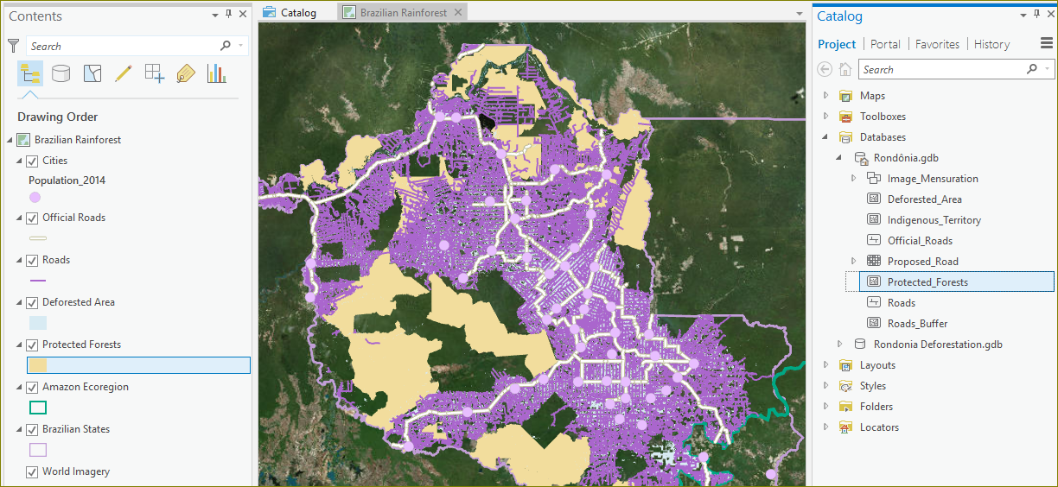
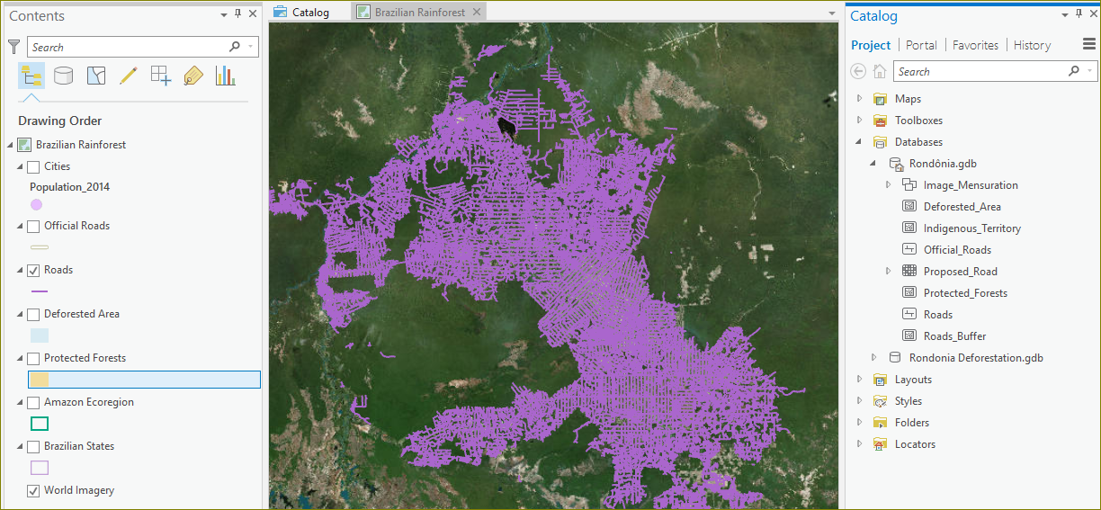
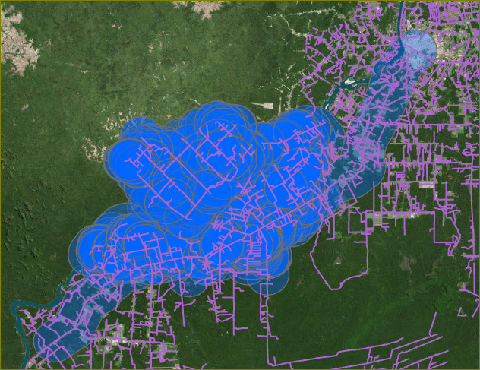
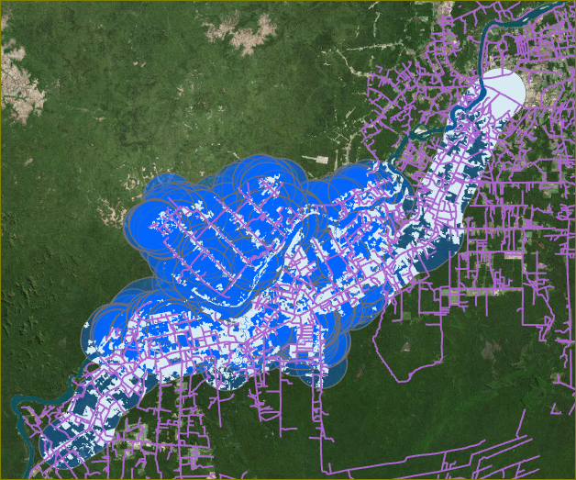
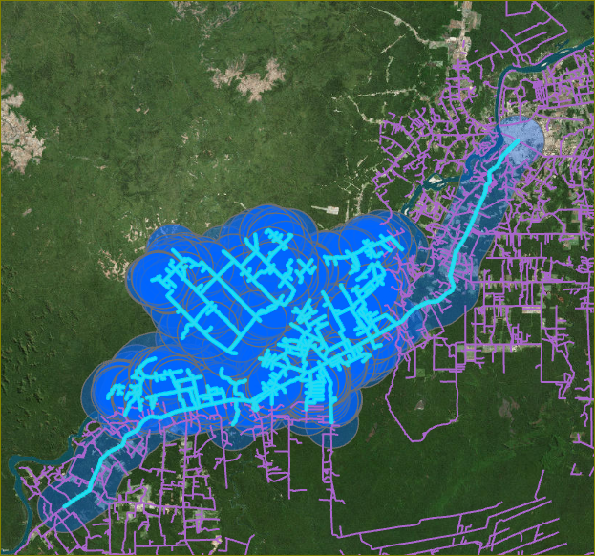
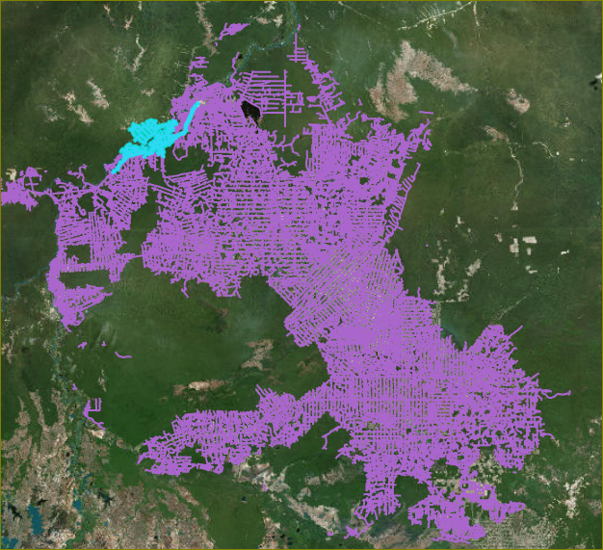
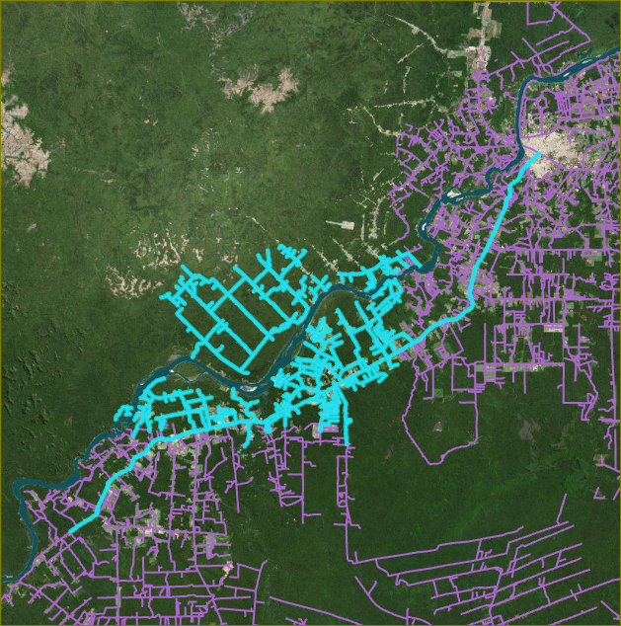
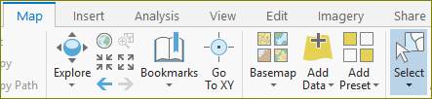
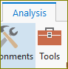
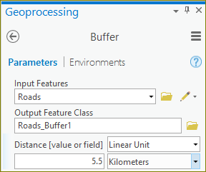
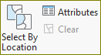
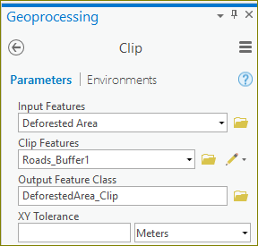
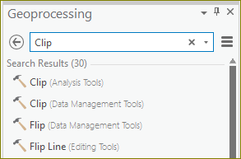
Deforestation near roads
Your goal is to estimate how much deforestation a proposed road would cause if its construction were allowed. To make this estimate, you'll first find how much deforestation is associated with existing roads.
1. Display the map with all layers turned on.
2. Turn off all layers except Roads and World Imagery.
3. Choose the ‘Map | Select | Rectangle’ and draw a small area to select.
4. Click ‘Map | Explore’ and then zoom to show the details.
5. Click ‘Analysis | Tools | Buffer’, select/input the params and press ‘Run’.
6. Clear the selected roads by clicking ‘Clear’ under ‘Map | Selection group’.
7. Click the back arrow on Geoprocessing, type in Clip and choose Clip tool.
8. Select/enter the params for Clip and Run the tool.
Next: Percentage Deforestation

Slide 7
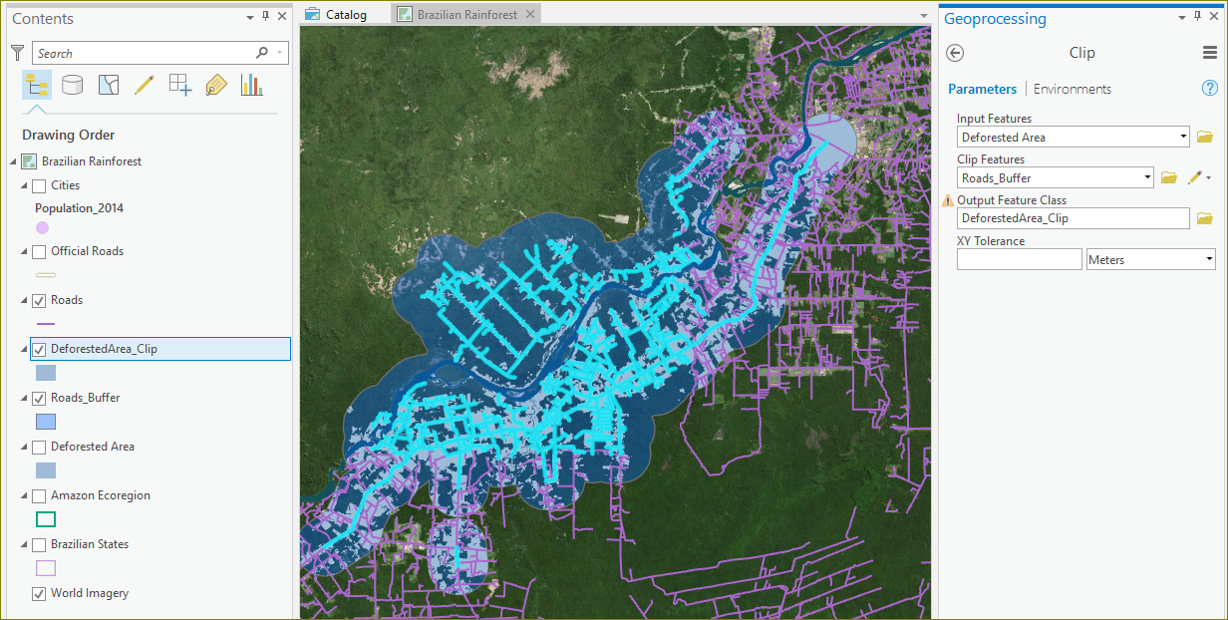
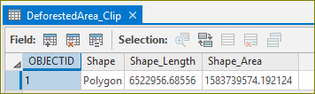
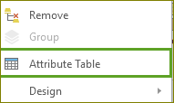
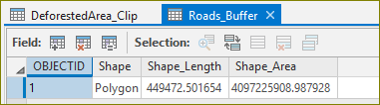


Percentage deforestation near roads
You've created two layers. One shows the area within 5.5 kilometers of the roads in your sample area. The other shows deforestation within that buffer. Your next goal is to calculate the percentage of the buffer that is deforested. To find the percentage, you'll calculate a new attribute field.
1. Right click ‘Contents | Deforestation_Clip’ and choose ‘Attribute Table’
2. Copy the value under ‘Shape_Area’ and save in clipboard or in a scratch pad.
3. Right click ‘Contents | Roads_Buffer’ and choose ‘Attribute Table’.
4. Click on ‘Field: Add Field’
5. Enter/select Field Name, Alias and Data Type.
Next: Continued…
6. Click ‘Save’ on the ‘Fields’ tab.

Slide 8



Percentage deforestation near roads. Cont.
7. In the Roads_Buffer table, right-click Percent Deforested and choose Calculate Field.
8. Type in the ‘Percentage_Deforested = ’ field the Shape_Area value saved from step 2 and then…
- Type /
- Click ‘Shape_Area’
- Type * 100
9. Click ‘Run’ and look under ‘Roads_Buffer’ table for the ‘Percent Deforested’ value.
Next: Using as a GSKY Client

Slide 9






















Using as a GSKY Client
This section describes the use of ArcGIS Pro as a GSKY client, much like TerriaMap is used as GSKY client. Not all functionalities of TerriaMap will be available and there are some errors not seen with TerriaMap. These errors are explained and suggestions to avoid them are given.
1. Run the application as ‘Start | ArcGIS Pro’
2. Click ‘Blank’ to start a new project or select an existing project.
3. Give the new project a name and storage location.
4. Under ‘Projects | Insert’ tab click on ‘New Map’, ‘New Global Scene’ or ‘New Local Scene’
5. Add the GSKY server via ‘Projects | Insert | Connections | New WMS Server’
6. Click ‘Catalog | Contents | Servers’
7. Double-click ‘GSKY Web Map Service on …’
- Repeat until the layers become visible.
8. Right-click the required layer and select ‘Add to Map’
9. Zoom and/or pan.
Errors
Zooming and panning may lose the layers.
The picture quality is low.
Cccasionally hangs the GSKY server.
End of Slides

Slide 10






Acknowledgements

